Slide 1
Mesoscale concrete model

Slide 2
Why to use mesoscle model?
To understand the mechanical behaviour and durability characteristics of concrete.
Fracture mechanics of concrete and how to improve the performance of concrete. By using mesoscale models to simulate the behavior of concrete, number of experimental tests can be reduced.

Slide 3
Analysis by Different method
Method
Continuum method
Discrete analysis method
Discrete mesoscale modelling represents the concrete mesostructure using distinct elements such as spheres, lattice beams, trusses etc.
Continuum mesoscale modelling represents the mesostructure of concrete as a continuum and mainly uses finite element method for the analysis.

Slide 4
Generation of geometry for meso-scale - continuum method
Concrete mesostructure is represented as a continuum with aggregates, mortar and ITZ when concrete is modelled as a three-phase material.
Method to generate geometry
Digital image approach
Parameterization approach

Slide 5
Digital image approach
Digital images of the concrete specimen are taken and using image processing techniques, these images are processed, and the mesoscale model is generated
There are two main approaches to generate the images of the concrete specimen.
Method
In the first method, concrete specimen is scraped and 2D images are taken using a scanner and these images are combined to get the full 3D geometry of the concrete specimen
Second method uses scanning of an actual concrete cube using X-ray computed tomography (XCT) scanners and generate mesh using the digitally scanned elements

Slide 6
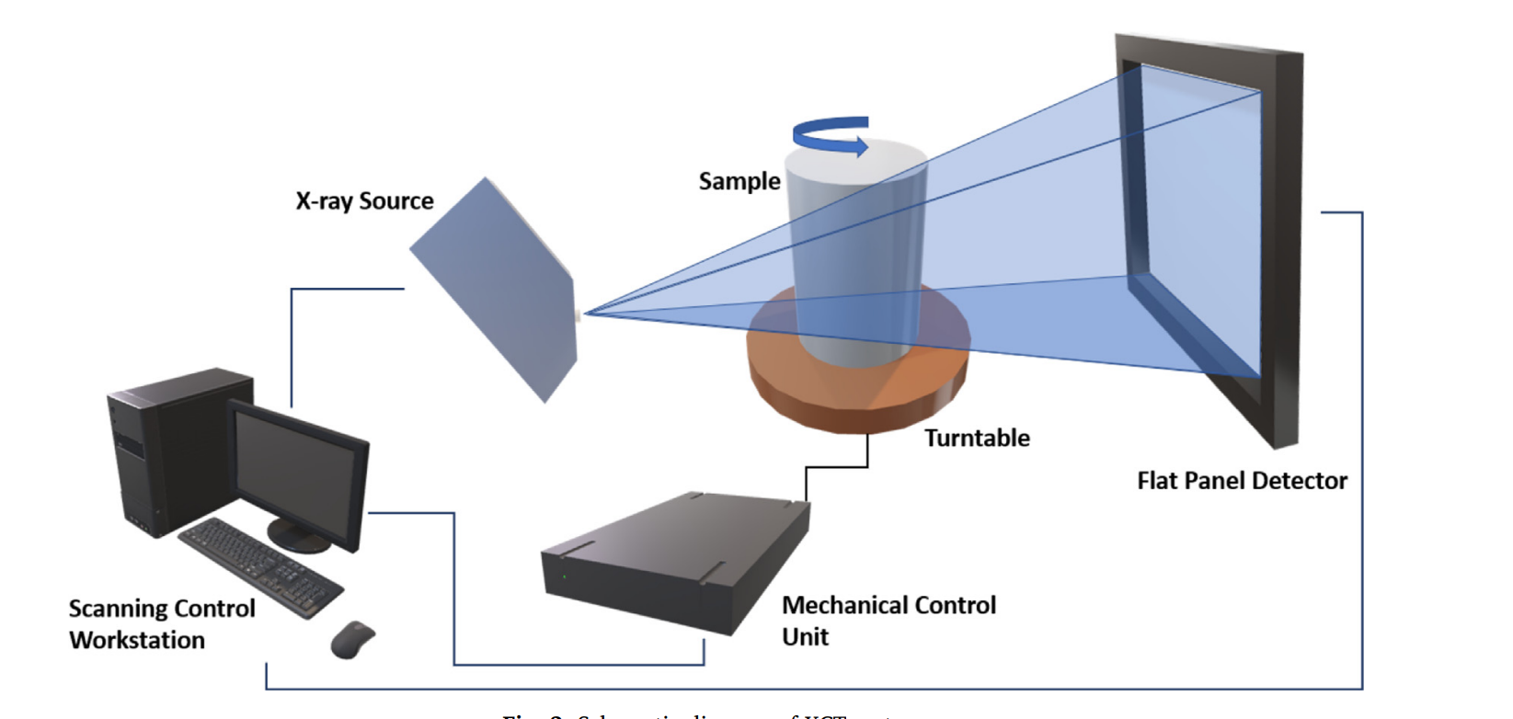
XCT method
Pixel size should be small enough to capture the geometry of the heterogeneities in the mesostructure and if the pixel size is too small, the number of elements will be increased, the size of an individual finite element will be reduced, and the simulation time will be increased.
Generally, each pixel will be modelled by a quadrilateral element in 2D or a voxel in 3D in finite element simulations.
However, if the overall fracture behavior of the sample needs to be observed, a larger volume needs to be modelled and this can be achieved using parameterization approach.

Slide 7
Parameterization modelling approach
In the parameterization approach, concrete mesostructure is generated using algorithms which represent the geometry of the mesostructure parametrically.
Aggregates will be represented using various shapes and these aggregates will be placed inside a volume and the mortar phase is represented by the volume surrounding the already placed aggregates.
Generation of the mesoscale models including shape generation of aggregates, methods to obtain optimum Particle Size Distribution (PSD), aggregate placing methods, generation of ITZ, and meshing techniques are discussed in this section.

Slide 8
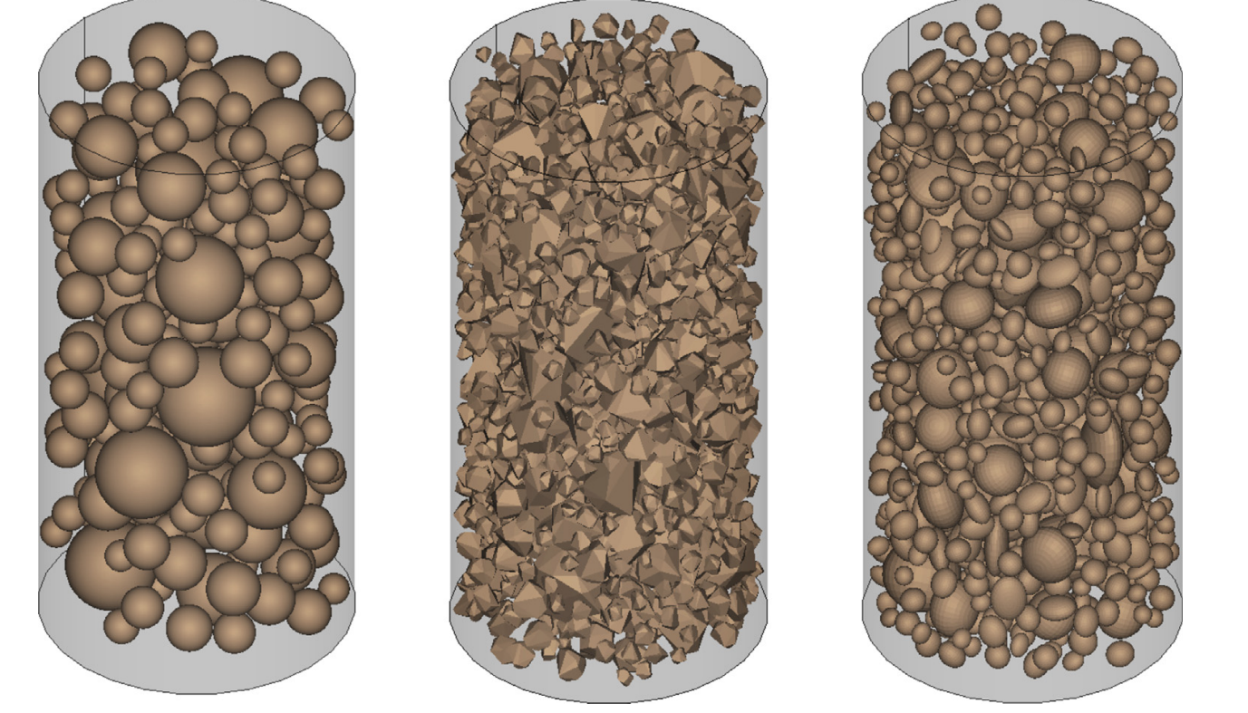
Using ellipsoids and spheres to represent uncrushed aggregate such as pea-gravel particles with smooth surfaces is realistic.
Polyhedrons have been used to represent the actual aggregate shape of the crushed aggregate particles.
Due to the angular nature of aggregate particles, local stress concentrations will occur, and these will lead to the crack initiation and polyhedral particles can realistically represent this behavior.

Slide 9
Analysis method and material constitutive models
After meshing the developed geometry, finite element method can be used to analyze the mesoscale model with suitable material models and properties assigned to the consisting phases.
To obtain an accurate response from the finite element analysis, using suitable material parameters and material constitutive models for the consisting phases is vital.
Material parameters which are needed for the simulation such as elastic modulus, Poisson ratio, uniaxial tensile strength, uniaxial compressive strength and damage parameters are generally taken using the past literature or conducting experiments.

Slide 10
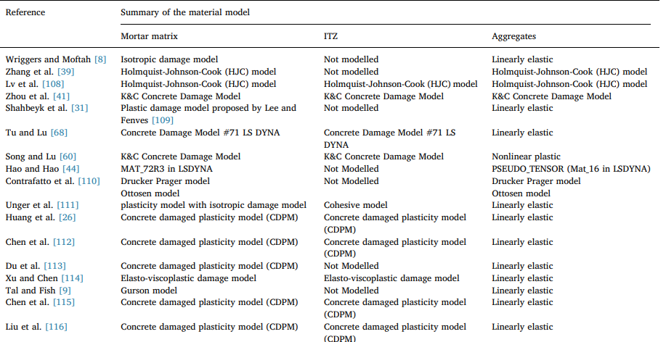
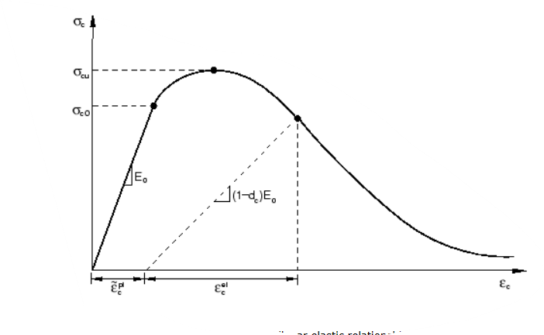
Summary of the material models used for consisting phases

Slide 11
Applications, pros and cons of different mesoscale model
Continuum methods – application
Parametric analysis is one main application of the mesoscale models. Using the parametric analysis, impact of critical parameters on the performance of the concrete can be investigated.
2D mesoscale model using circular aggregates and carried out a parametric analysis by varying critical parameters such as aggregate volume fraction. Concrete model was tested for varying aggregate volume fractions and it was found that when the aggregate volume fraction is increased, cracks in the concrete get localized and the stiffness of concrete increases.
Developed a 2D mesoscale model using ellipsoidal particle shapes and analyzed the effect of aggregate volume fraction, percentage of pores present in the area and the size of the concrete specimen. It was found that with the increase of size of the concrete specimen, volume fraction of aggregates and percentage of pores in concrete, the peak strength of the concrete reduces.
Concrete fracture and damage propagation behavior is another main researched area using mesoscale models shows the fracture behavior obtained from continuum mesoscale modelling for concrete under uniaxial tension.

Slide 12
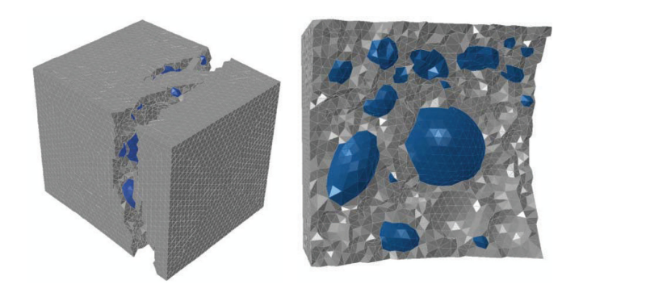

Slide 13
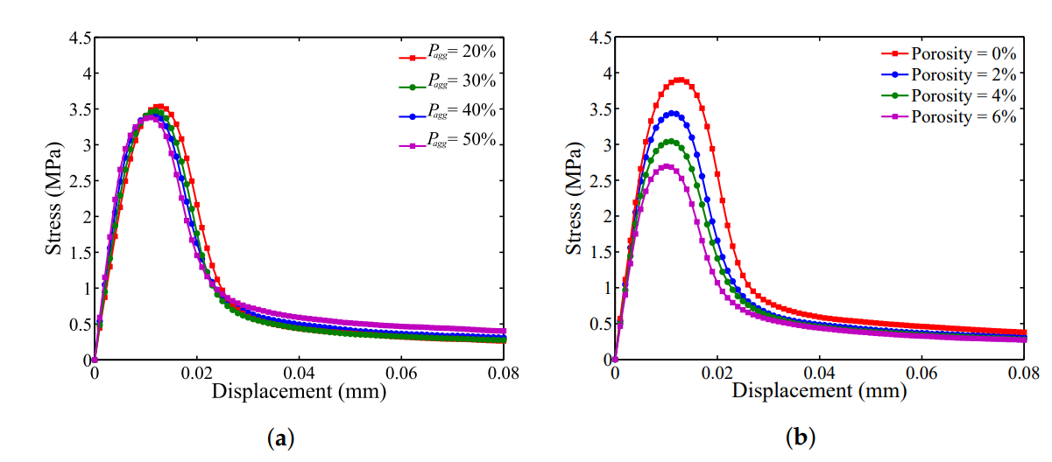
Effect of Aggregate Volume Fraction

Slide 14
Continuum methods – Pros and Con
In the continuum method, the geometry of the mesostructure of the concrete can be generated explicitly compared with the discrete models.
Aggregates can be realistically modeled according to a particle size distribution curve satisfying the required volume fraction. Hence, continuum methods are more suitable for parametric analysis compared with the discrete models.
Continuum methods have complex constitutive relations to represent the behavior of consisting phases.
Number of material parameters to describe the material behavior is higher compared to the discrete models and obtaining accurate material parameters for all three phases is challenging.
Mesh sensitivity of the models will affect the results of the simulations and hence a proper size of mesh needs to be selected. However, when the mesh size is too small, the computational resource requirement increases significantly.
Suitable material models for each consisting phase must be selected and this selection can affect the final results from the simulation.
In continuum models, fracture path is not generally predefined other than the case where the cohesive elements are preinserted. Hence, a realistic fracture initiation and progression can be obtained compared with the discrete models.
Continuum models is that the material parameters for one stress state can be used to simulate behavior in another stress state and obtain accurate behavior in that loading conditions.

Slide 15
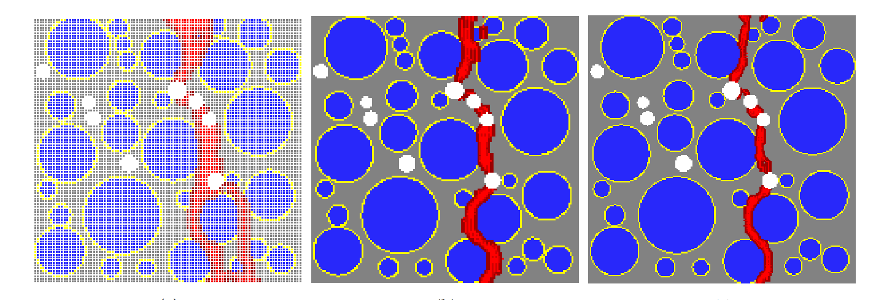
Effect of meshing

Slide 16
Discrete element method - applications
Main application of DEM in mesoscale models is the simulation of fracture behavior of concrete.
Parametric studies to investigate the effect of aggregate strength and aggregate shape on the strength of concrete.
It should be noted that DEM is less suitable method to carry out the parametric studies compared with the continuum finite element method. Discrete element method.

Slide 17
Discrete element method – Pros and cons
DEM uses simple constitutive laws to represent the material behavior compared with the continuum finite element method.
the number of parameters for the constitutive law is smaller and computationally more efficient.
Discrete element methods require more computational resources compared with the continuum methods.

Slide 18
conclusions
Digital image-based approach is suitable for analyzing the actual concrete samples and it can be concluded for parametric studies and statistical analysis of results, parameterization approach is best suited.
Mesoscale models for continuum models can be analyzed in 2D or in 3D. It can be concluded that 3D models give better representation compared with the 2D models. parameterization approach is best suited.
Aggregate particles can be spherical, ellipsoidal or polyhedral in 3D and polyhedral shape can give realistic results compared with other two shapes.
Coupled damage and plasticity models are used widely to represent the mortar in continuum methods.
Aggregates are represented as a linear elastic material. However, aggregates should also have a coupled damage plasticity behaviour in concrete under dynamic loading or in very high strength concrete since failure goes through aggregate.
Simple constitutive relations are used in discrete analysis methods compared to the continuum methods and hence the number of parameters which describes the material behavior is smaller.
Main application of mesoscale modelling is fracture mechanics of concrete and it can be concluded mesoscale modelling can be successfully used for many other applications such as parametric analysis of concrete, behaviour of concrete under various loading conditions.

